Slide 1
Applied Research Project
Zyp Art Gallery Social Media Dashboard Application
Kunal Ajaykumar Jeshang (300328339)

Slide 2
Presentation

Slide 3
Problem I am trying to solve
Help Zyp Art Gallery to visualize and derive insights from its extracted social media data
Deriving more insights from social media data will allow the organization to make more strategic decisions to acquire more donations and make a greater impact on its surrounding community.
As it is a non-profit organization, Zyp Art Gallery does not have the funds to acquire a Microsoft Power Suite or Tableau license.
Power BI is free but without the license, we do not have the ability to use Power BI service to share dashboards to other members/volunteers of the organization.
Tableau may have a free public version but the dashboards are saved online (NOT locally), and the published dashboard’s community portal is not known to keep sensitive data safe.
It is challenging to teach non-tech savvy people how to install these softwares.
Not every volunteer will have a powerful computer running the appropriate operating system to run these softwares.

Slide 4
Problem I am trying to solve (cont.)
Google Data Studio was considered due our use of G Suite.
The platform is not powerful enough to process, aggregate & analyze our large social media datasets which leads to an error being thrown.
Pre-existing dashboard softwares tend to have some operational drawbacks
Limited interactivity (to a certain degree)
Fixed dimensions
Runs slow or incompatible with older devices
Challenging install process for those that are not tech-savvy
Free versions have less features to best-assist the needs of organization (including a non-profit)
Thus, this project’s end result is to construct a custom dashboard application that is free, accessible, and easy-to-use.

Slide 5
Target Audience
Zyp Art Gallery volunteers
Analytics team (my team)
Marketing team
Maybe the Business Analyst team
Zyp Art Gallery members (i.e., paid employees)
Executive Director
Calmar Art Society
Founder/President
Chair/s
Secretary

Slide 6
Significance of Research Project
Significance to the organization
Assisting it to derive social media insights will better inform them what strategic business decisions need to be taken to widen its outreach in terms of endeavors to showcase artwork of local artists, help its surrounding community, provide meaningful experiences to its volunteers, etc.
Understand what more it needs to do increase its social media presence, as this can encourage current/prospective followers to get involved and make donations, in turn, maintaining/improving the financial longevity and positive impact of the non-profit.
Significance to me
Make an positive contribution to organization that's intent is provide a “voice to the voiceless”, and providing selfless-service to help those in need.
Application of knowledge & skills gained from PBD CSIS Data Analytics
Getting to apply my software development knowledge to create a multi-layer application
Getting to apply my data analytics knowledge to clean, aggregate, filter, analyze, and visualize data to derive meaningful insights

Slide 7
Overview of plans to develop project
Technologies below would be used to create a custom multi-page dashboard web application:
Programming language = Python 3.8.9+
IDE = Microsoft VS Code
Development = Python scripts in a multi-layer file structure
Prototyping of both analysis and visualization = Jupyter Notebook
Important packages = gspread, pandas, datetime, numpy, plotly, dash, gunicorn, flask
Data source = Social Media data files in CSV file format in Google Sheets file format from organization’s Google Drive (accessible via Google Drive & Google Sheets API using a Google Service Account private key)
Social media extraction code is separate from project but necessary to get up-to-date social media data
Version control = Git
Hosting & Deployment = GitHub & Heroku
Performing first time deployment using PyCharm Community Edition

Slide 8
Project Demonstration
Link: https://zyp-social-media-dash-app.herokuapp.com/

Slide 9
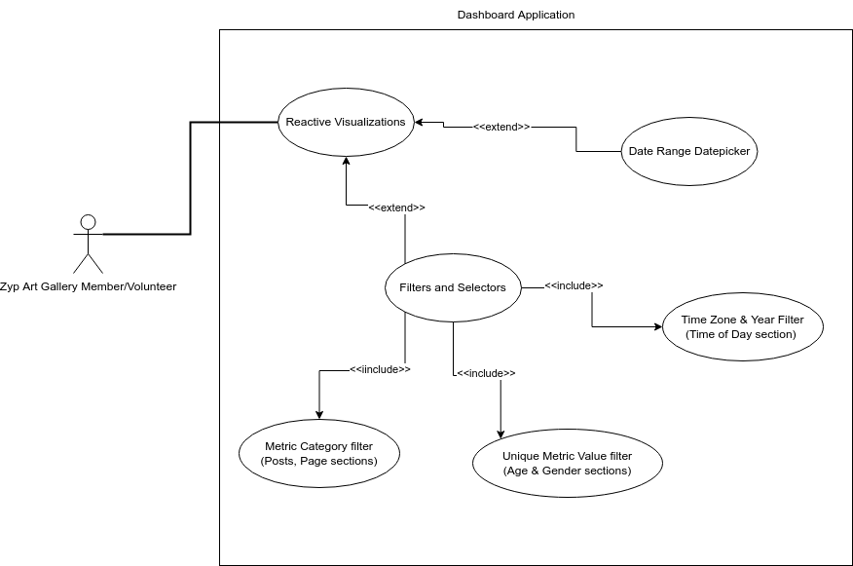
Software Design Architecture - UML (Use Case Diagram)

Slide 10
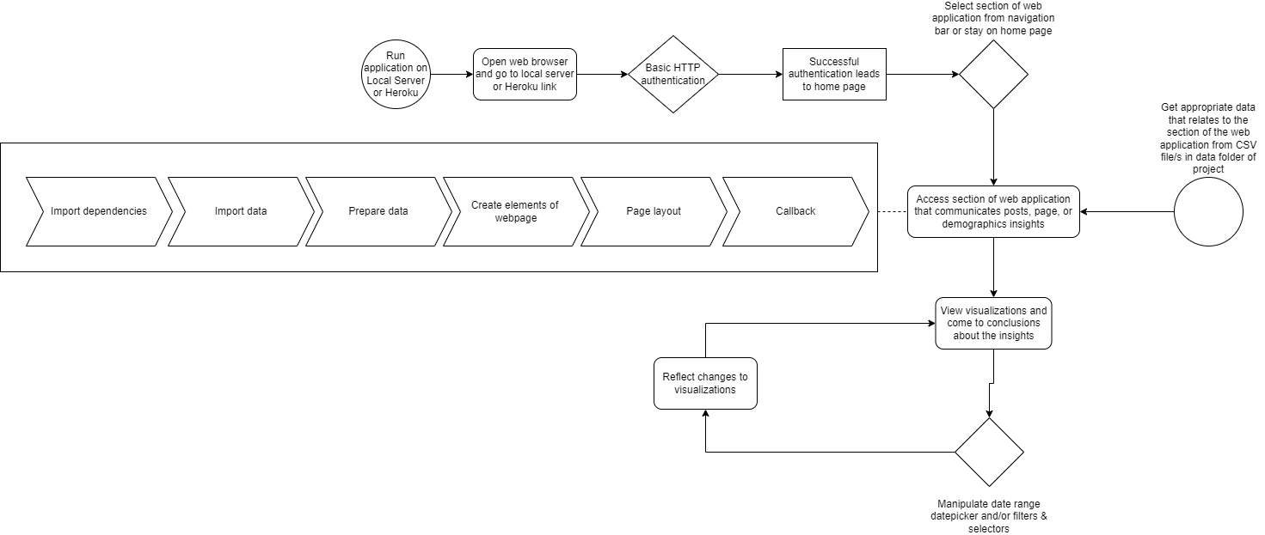
Software Design Architecture - UML (Activity Diagram)

Slide 11
Software Design Architecture - Design Pattern
Three features of Dash app
Layout (involve rendering of web elements and structure)
Components (involve rendering and managing interactivity of web elements)
Callbacks (enact the action to enable interactivity of web elements)
Project file structure
Assets folder
Google Service Account private key (authenticates retrieval of data)
googleService.py (contains function to retrieve username & password data as a pandas dataframe)
Country code ISO CSV
Canadian Cities & Towns CSV (contains name, province, longitude, and latitude information)
Data folder: Holds social media data files that are in CSV file format
Apps folder: Scripts dedicated to showing the main content (i.e., visualizations and related-interactive web elements) using files from assets & data folder
App.py
Instantiates the Dash application, server, and authentication as variables
Index.py
Imports the variables from “app.py”
Creates a general skeleton of application
Connects all scripts in apps folder via a navigation bar
Dedicated to running Dash app on local server and/or Heroku

Slide 12
In-Person Defense

Slide 13
Brief Description of Project
Help derive insights of Zyp Art Gallery’s Facebook and Instagram data in the form of a custom dashboard application that is accessible online via a web browser and is easy-to-use
Primary target audience = Zyp Art Gallery Analytics Team
The application is built using Python, and Plotly Dash (as well as other related packages)
Each section of the application is divided into two parts: one part is dedicated to Facebook and the other part is dedicated to Instagram
The application attempts to visualize posts, page, and audience insights per social media platform
The data source of the application are CSV files that contain social media data
I have a separate collection of scripts designed to extract data from Facebook Graph API

Slide 14
Proof Objectives were met (myself) – Part 1
Is the application easy to access by those that are part of the Zyp Art Gallery organization?
Yes the application is easy to access as it is deployed to Heroku
The application uses basic HTTP authentication for security, but login credentials would be provided by me
Is the application easy to use even for a non-technical person?
Yes it is as it is a web application, thus it functions like one as well
Filtration options and navigation use common interactive web elements
User experience suffers due to large processing time of Canadian City sections; at times, request would timeout (as processing time > 30 seconds) and not render at all
Is the application overall aesthetically pleasing?
Yes it is (at least to me)
There has not been any major comment of aesthetics from the Zyp Analytics team; they are all mostly satisfied with it
LUX theme = similar to Zyp Art Gallery logo theme

Slide 15
Proof Objectives were met (myself) – Part 2
Does the application follow a logical design in regards to navigation?
Navigation bar is consistent through whilst moving through the various pages of the application
The codebase also follows a logical design as the application centers around the “index.py”
Are the visualizations detailed & informative, yet easy on the eyes?
Inspired by visualizations from ‘Later’ and ‘Facebook for Business’
Inspired by dashboards made by other team members
Tried to enhance the visualizations based on filtration options and granularity
Do the visualizations have a good degree of interactivity in terms of date range, category, and/or any other identifier?
Canadian City sections may render slowly so it affects the idea of speedy interactivity; also the dataset size has been greatly reduced
All other sections have maximum possible interactivity (in my opinion)

Slide 16
Proof Objectives were met (Zyp Analytics Team Meeting on July 22nd 2022) – Part 1
 | Jaime | Tanmay | Sandeep
Is the application easy to access by those that are part of the Zyp Art Gallery organization? | Yes it is | Yes it is. Good job! August 4th 2022 update: Facebook Canadian City section not rendering Lifetime Likes visualizations | Yes it is.
Is the application easy to use even for a non-technical person? | Yes. It is easy to use. | Yes. It looks easy to use. | Yes. It looks easy to use for an Analytics team member. Try to ask a parent or younger person to see if they understand the application to get a more definitive answer regarding the question the context of a non-technical person.

Slide 17
Proof Objectives were met (Zyp Analytics Team Meeting on July 22nd 2022) – Part 2
 | Jaime | Tanmay | Sandeep
Is the application overall aesthetically pleasing? | Application is pleasing to the eyes. | Application is pleasing to the eyes. | Application is pleasing to the eyes.
Does the application follow a logical design in regards to navigation? | Yes it is good. | Yes it is good. The arrows on the Facebook & Instagram dropdown menus could be larger and more visible. | Yes it is all good.

Slide 18
Proof Objectives were met (Zyp Analytics Team Meeting on July 22nd 2022) – Part 3
 | Jaime | Tanmay | Sandeep
Are the visualizations detailed & informative, yet easy on the eyes? | Yes all good. | All good. The Instagram Posts table should have a title. Axis labels could be in bold so the user understands the visualized data better. | Yes all good.
Do the visualizations have a good degree of interactivity in terms of date range, category, and/or any other identifier? | Interactivity is good. | Interactivity is good. The Canadian City section runs slower. Try to reduce the dataset size. The row values of older years are not necessary so they can be removed from the data file in regards to the project. | Interactivity is good.

Slide 19
Deployable, customizable, easy-to-use, …
Deployable?
Application is already deployed to Heroku
Login instructions provided to target audience (via Discord & Organization Google Drive) and Instructor (via Blackboard Submission)
Link: https://zyp-social-media-dash-app.herokuapp.com/
Easy-to-Use
Based on feedback from Zyp Art Gallery Analytics team and my design choices
According to Analytics team leader, the user experience could be improved; thus, the application could be designed to be more easier to use

Slide 20
Deployable, customizable, easy-to-use, … (cont.)
Customizable
Facebook
Posts insights: filter by date range, post metric category, and post ID
Page insights: filter by date range, page metric category
Audience Age & Gender insights: filter by date range, gender identity, age range
Audience Country insights: filter by date range, region scope
Audience Canadian City insights: filter by date range, subregion scope
Audience Time of Day insights: filter by date range, time zone, year
Instagram
Post insights: filter by Post ID
Page insights: filter by date range
Audience Age & Gender insights: filter by year, week, gender identity, age range
Audience Country insights: filter by year, week, region scope
Audience Canadian City insights: filter by year, week, subregion scope
Audience Time of Day insights: filter by year, week, time zone

Slide 21
Algorithms – Not really
There are no particular algorithms used
The highest degree of mathematics used in this application is descriptive statistics (i.e., calculating average daily reach by Age, Gender, Country, Canadian City)
The Dash application does follow a specific design pattern (discussed in the Final Presentation Recording)
Import dependencies (e.g., Python packages & other Python files in project directory/sub-directory)
Import data (i.e., CSV files)
Create elements of webpage (e.g., headings, date range picker, dropdowns, checklist, visualizations) – either fully or partially
Create structure and layout using elements of webpage
Callbacks
Takes input of interactive web elements (i.e., date range picker & dropdowns), and then returns output (i.e., visualization)
Web elements identified for input & output using “id”
Example: https://github.com/kjeshang/ZypArtGallerySocialMediaDashboard/blob/main/SocialMediaDashboard-Zyp/apps/IG_Section_Page.py

Slide 22
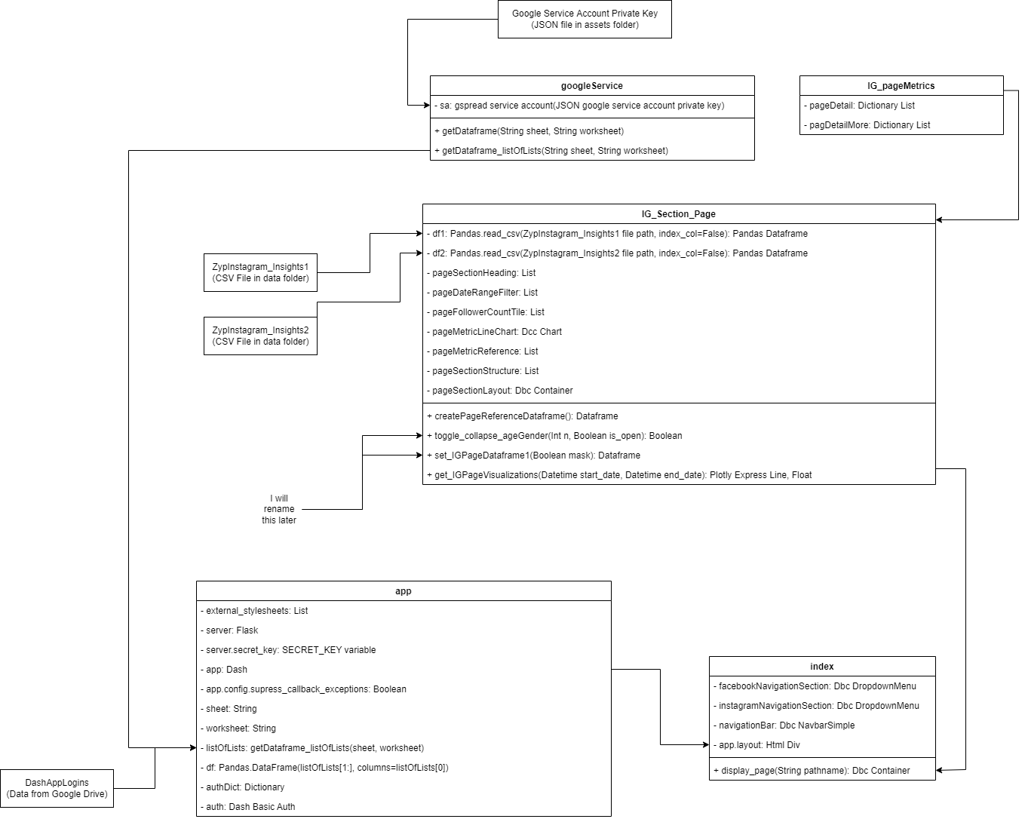
Algorithms – Not really (cont.)
Example UML Class Diagram
This shows in a more granular way the flow of the application flows for a particular section of the application.

Slide 23
For more information, please kindly refer to the Final Report. If you require any clarification or have any questions, please reach out. Thank you!

